Slide 1
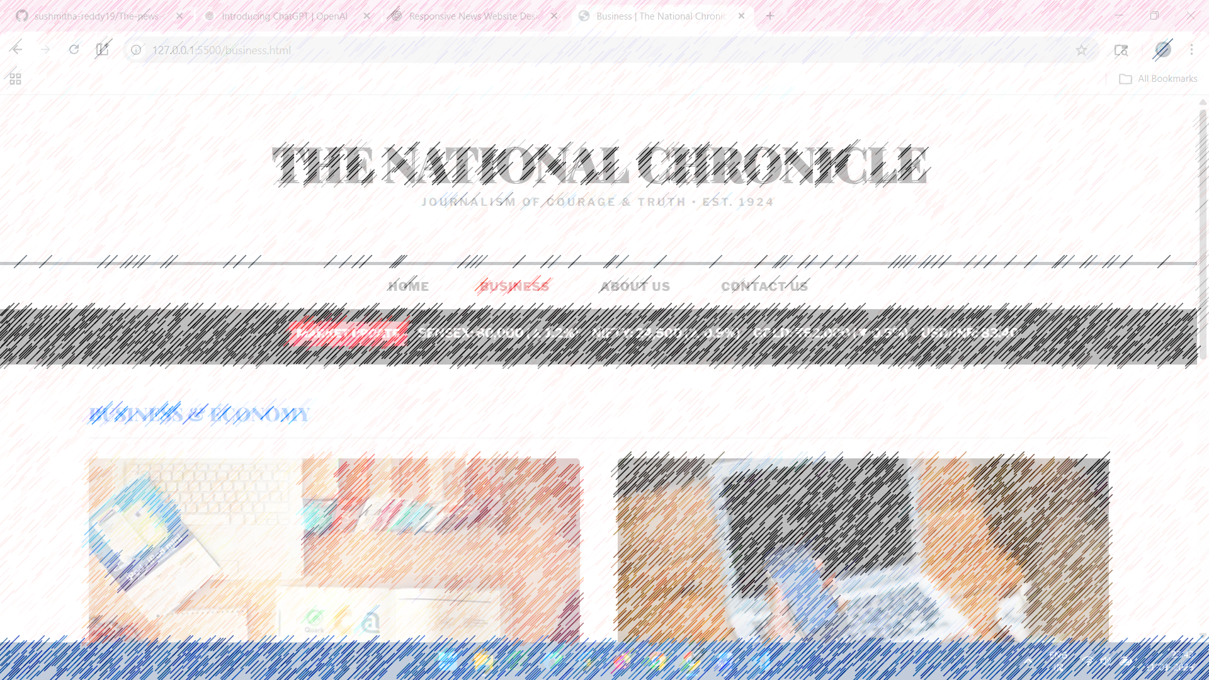

The National chronicle

Slide 2


The National chronicle
Background: Traditional news delivery (print) faces delays and high costs.
The Shift: Digital platforms allow for real-time reporting and global reach.
Project Scope: A modern, web-based newspaper prototype focusing on clean UI, authoritative branding, and seamless user experience.

Slide 3

01
Introduction
02
Client Side Demo
Problem Statement
Project Scope
Project Modules
Challenges & Methodologies
Run the project using link (hosted version).
Navigate and demonstrate the services
Agenda
03
Technical Demo
04
Conclusion
Show the functionalities.
Show the documentation part.
Show the integrations
Conclusion
Future Scope
References

Slide 4

Introduction
The National Chronicle is a comprehensive, responsive digital news application designed to bridge this gap. This project serves as a sophisticated prototype that replicates the workflow of a professional news organization. It emphasizes a "Broadsheet Grid" layout—reminiscent of established publications like The Hindu—ensuring that high-impact headlines, investigative reports, and multimedia content are organized in a clean, high-hierarchy interface.

Slide 5

Introduction – Project Overview
01
Problem Statement The project titled The Global Times is a static news website designed using HTML and in-built CSS. The aim of this project is to create a website that looks similar to real news platforms such as The Hindu. .
02
Project Scope The scope of this project is limited to frontend development. The website consists of four HTML pages that are properly linked and responsive across different screen sizes. This include backend development, database connectivity, or real-time news updates
03
Project Modules The system includes Home, About, business, Voting, and Contact page
04
Challenges & Methodology The main challenges faced during this project were creating a newspaper-style layout using only HTML and CSS and maintaining responsiveness across different devices. Since the website is static, it does not support dynamic content or live news updates..

Slide 6
Client Demo
Run app and demonstrate

Slide 7
Client Side Demonstration
Display the Home page with centered logo and navigation bar
Show headline news and latest updates section
🧑‍💼 Client Demonstration – Navigation
Navigate between Home, About, Business, and Contact pages
Show smooth and easy page linking
🧑‍💼 Client Demonstration – About Page
Explain the purpose and mission of the website
Show content and image layout
🧑‍💼 Client Demonstration – Business Page
Display business and market news articles
Show image-based news cards
🧑‍💼 Client Demonstration – Contact Page
Demonstrate the contact form
Show embedded Google Map
01
02
03
04

Slide 8
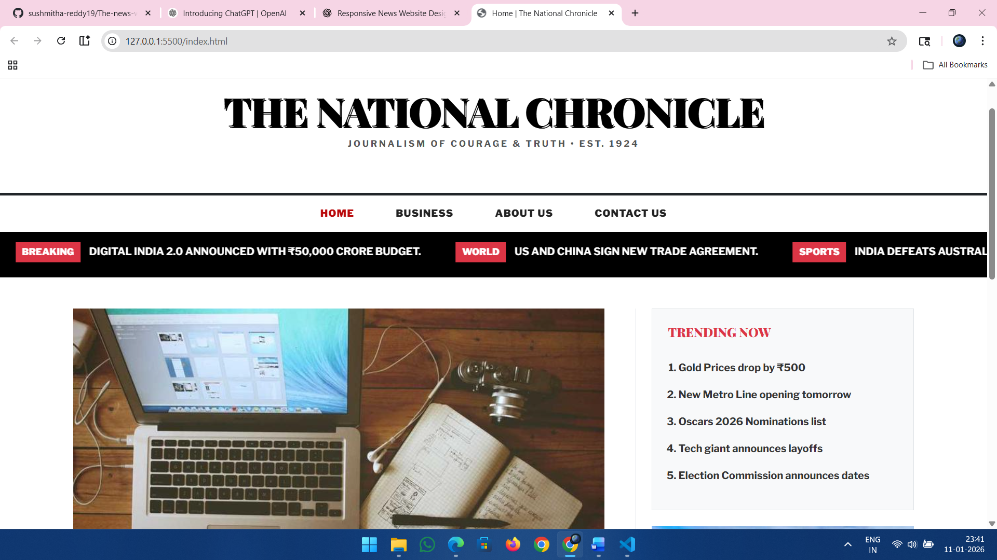
Client Side Screens – The national chronicle

Slide 9
Technical Demo
Source Code – Integration - Documentation

Slide 10
Technical Demonstration
01
Project Structure
Explaining the folder structure and file organization of the project.
02
Frontend Technologies
HTML, CSS, Bootstrap used for building responsive UI.
03
Styling & Responsiveness
CSS and Bootstrap grid system used for responsive design.
04
Version Control & Hosting
GitHub used for version control and GitHub Pages for hosting.

Slide 11
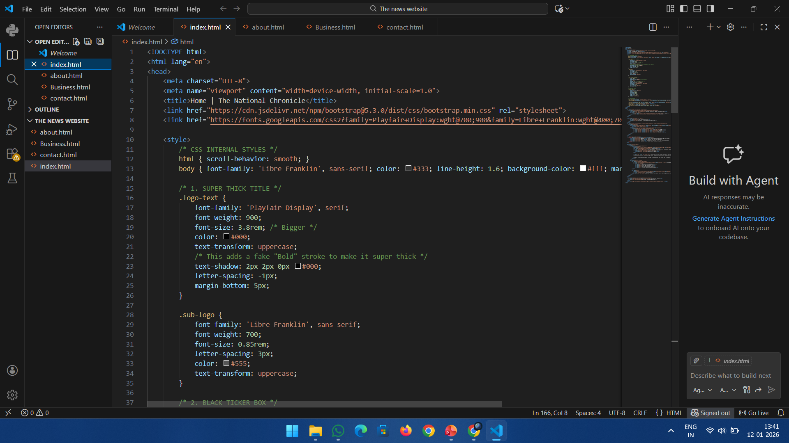
Technical Implementation Screens
Code structure and technical components of the system

Slide 12

Conclusion
This project successfully demonstrates the design and development of a fully responsive static news website using HTML and in-built CSS. The website includes multiple pages, proper navigation, and basic user interaction. It follows responsive design and SEO-friendly structure. Overall, this project helped in understanding real-world website layout, frontend development concepts, and hosting a website using GitHub Pages.

Slide 13

Future Scope
In the future, this static news website can be improved by adding JavaScript to make the website more interactive. Backend technologies and a database can be integrated to support real-time news updates and user login. The project can also be converted into a React application for better performance and scalability.

Slide 14
References
https://developer.mozilla.org/
https://www.w3schools.com/
https://www.figma.com/
https://fonts.google.com/
https://unsplash.com/
https://htmlcolorcodes.com/

Slide 15
THANK YOU

